Slide 1
UNIT-3

Slide 2
First-Order Logic in Artificial intelligence
In the topic of Propositional logic, we have seen that how to represent statements using propositional logic. But unfortunately, in propositional logic, we can only represent the facts, which are either true or false. PL is not sufficient to represent the complex sentences or natural language statements. The propositional logic has very limited expressive power. Consider the following sentence, which we cannot represent using PL logic.
"Some humans are intelligent", or
"Sachin likes cricket."
To represent the above statements, PL logic is not sufficient, so we required some more powerful logic, such as first-order logic.

Slide 3
First-Order logic:
First-order logic is another way of knowledge representation in artificial intelligence. It is an extension to propositional logic.
FOL is sufficiently expressive to represent the natural language statements in a concise way.
First-order logic is also known as Predicate logic or First-order predicate logic. First-order logic is a powerful language that develops information about the objects in a more easy way and can also express the relationship between those objects.
First-order logic (like natural language) does not only assume that the world contains facts like propositional logic but also assumes the following things in the world:
Objects: A, B, people, numbers, colors, wars, theories, squares, pits, wumpus, ......
Relations: It can be unary relation such as: red, round, is adjacent, or n-any relation such as: the sister of, brother of, has color, comes between
Function: Father of, best friend, third inning of, end of, ......

Slide 4
As a natural language, first-order logic also has two main parts:
Syntax
Semantics
Syntax of First-Order logic:
The syntax of FOL determines which collection of symbols is a logical expression in first-order logic. The basic syntactic elements of first-order logic are symbols. We write statements in short-hand notation in FOL.
Basic Elements of First-order logic:
Following are the basic elements of FOL syntax:
Constant | 1, 2, A, John, Mumbai, cat,....
Variables | x, y, z, a, b,....
Predicates | Brother, Father, >,....
Function | sqrt, LeftLegOf, ....
Connectives | ∧, ∨, ¬, ⇒, ⇔
Equality | ==
Quantifier | ∀, ∃

Slide 5
Atomic sentences:
Atomic sentences are the most basic sentences of first-order logic. These sentences are formed from a predicate symbol followed by a parenthesis with a sequence of terms.
We can represent atomic sentences as Predicate (term1, term2, ......, term n).
Example: Ravi and Ajay are brothers: => Brothers(Ravi, Ajay). Chinky is a cat: => cat (Chinky).
Complex Sentences:
Complex sentences are made by combining atomic sentences using connectives.
First-order logic statements can be divided into two parts:
Subject: Subject is the main part of the statement.
Predicate: A predicate can be defined as a relation, which binds two atoms together in a statement.
Consider the statement: "x is an integer.", it consists of two parts, the first part x is the subject of the statement and second part "is an integer," is known as a predicate.

Slide 6
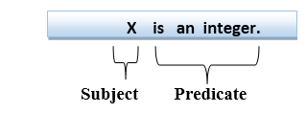

Slide 7
Quantifiers in First-order logic:
A quantifier is a language element which generates quantification.
These are the symbols that permit to determine or identify the range and scope of the variable in the logical expression. There are two types of quantifier:
Universal Quantifier, (for all, everyone, everything)
Existential quantifier, (for some, at least one).
Universal Quantifier:
Universal quantifier is a symbol of logical representation, which specifies that the statement within its range is true for everything or every instance of a particular thing.
The Universal quantifier is represented by a symbol ∀, which resembles an inverted A.

Slide 8
If x is a variable, then ∀x is read as:
For all x
For each x
For every x.
Example:
All man drink coffee.
Let a variable x which refers to a cat so all x can be represented in UOD as below:

Slide 9
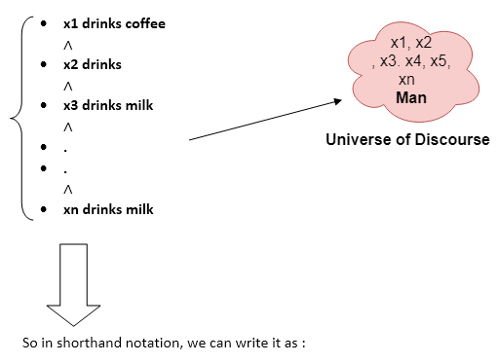

Slide 10
∀x man(x) → drink (x, coffee).
It will be read as: There are all x where x is a man who drink coffee.
Existential Quantifier:
Existential quantifiers are the type of quantifiers, which express that the statement within its scope is true for at least one instance of something.
It is denoted by the logical operator ∃, which resembles as inverted E. When it is used with a predicate variable then it is called as an existential quantifier.
If x is a variable, then existential quantifier will be ∃x or ∃(x). And it will be read as:
There exists a 'x.'
For some 'x.'
For at least one 'x.'

Slide 11
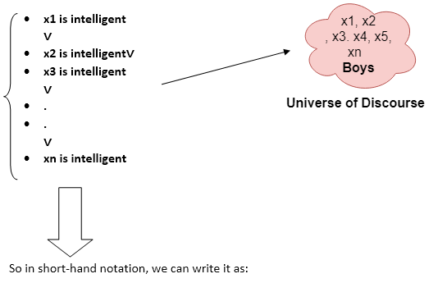

Slide 12
∃x: boys(x) ∧ intelligent(x)
It will be read as: There are some x where x is a boy who is intelligent.
Points to remember:
The main connective for universal quantifier ∀ is implication →.
The main connective for existential quantifier ∃ is and ∧.
Properties of Quantifiers:
In universal quantifier, ∀x∀y is similar to ∀y∀x.
In Existential quantifier, ∃x∃y is similar to ∃y∃x.
∃x∀y is not similar to ∀y∃x.
Some Examples of FOL using quantifier:
1. All birds fly. In this question the predicate is "fly(bird)." And since there are all birds who fly so it will be represented as follows. ∀x bird(x) →fly(x).

Slide 13
2. Every man respects his parent. In this question, the predicate is "respect(x, y)," where x=man, and y= parent. Since there is every man so will use ∀, and it will be represented as follows: ∀x man(x) → respects (x, parent).
3. Some boys play cricket. In this question, the predicate is "play(x, y)," where x= boys, and y= game. Since there are some boys so we will use ∃, and it will be represented as: ∃x boys(x) → play(x, cricket).
4. Not all students like both Mathematics and Science. In this question, the predicate is "like(x, y)," where x= student, and y= subject. Since there are not all students, so we will use ∀ with negation, so following representation for this: ¬∀ (x) [ student(x) → like(x, Mathematics) ∧ like(x, Science)].

Slide 14
Free and Bound Variables:
The quantifiers interact with variables which appear in a suitable way. There are two types of variables in First-order logic which are given below:
Free Variable: A variable is said to be a free variable in a formula if it occurs outside the scope of the quantifier.
Example: ∀x ∃(y)[P (x, y, z)], where z is a free variable.
Bound Variable: A variable is said to be a bound variable in a formula if it occurs within the scope of the quantifier.
Example: ∀x [A (x) B( y)], here x and y are the bound variables.

Slide 15
Knowledge Engineering in First-order logic
What is knowledge-engineering?
The process of constructing a knowledge-base in first-order logic is called as knowledge- engineering. In knowledge-engineering, someone who investigates a particular domain, learns important concept of that domain, and generates a formal representation of the objects, is known as knowledge engineer.
In this topic, we will understand the Knowledge engineering process in an electronic circuit domain, which is already familiar. This approach is mainly suitable for creating special-purpose knowledge base.
The knowledge-engineering process:
Following are some main steps of the knowledge-engineering process. Using these steps, we will develop a knowledge base which will allow us to reason about digital circuit (One-bit full adder) which is given below

Slide 16
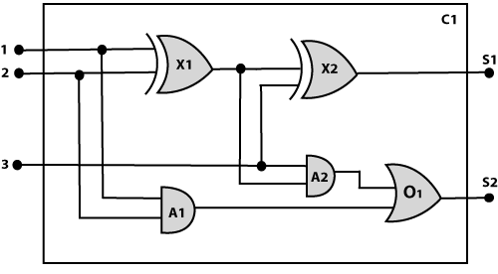

Slide 17
1. Identify the task:
The first step of the process is to identify the task, and for the digital circuit, there are various reasoning tasks.
At the first level or highest level, we will examine the functionality of the circuit:
Does the circuit add properly?
What will be the output of gate A2, if all the inputs are high?
At the second level, we will examine the circuit structure details such as:
Which gate is connected to the first input terminal?
Does the circuit have feedback loops?
2. Assemble the relevant knowledge:
In the second step, we will assemble the relevant knowledge which is required for digital circuits. So for digital circuits, we have the following required knowledge:

Slide 18
Logic circuits are made up of wires and gates.
Signal flows through wires to the input terminal of the gate, and each gate produces the corresponding output which flows further.
In this logic circuit, there are four types of gates used: AND, OR, XOR, and NOT.
All these gates have one output terminal and two input terminals (except NOT gate, it has one input terminal).
3. Decide on vocabulary:
The next step of the process is to select functions, predicate, and constants to represent the circuits, terminals, signals, and gates. Firstly we will distinguish the gates from each other and from other objects. Each gate is represented as an object which is named by a constant, such as, Gate(X1). The functionality of each gate is determined by its type, which is taken as constants such as AND, OR, XOR, or NOT. Circuits will be identified by a predicate: Circuit (C1).
For the terminal, we will use predicate: Terminal(x).
For gate input, we will use the function In(1, X1) for denoting the first input terminal of the gate, and for output terminal we will use Out (1, X1).

Slide 19
The function Arity(c, i, j) is used to denote that circuit c has i input, j output.
The connectivity between gates can be represented by predicate Connect(Out(1, X1), In(1, X1)).
We use a unary predicate On (t), which is true if the signal at a terminal is on.
4. Encode general knowledge about the domain:
To encode the general knowledge about the logic circuit, we need some following rules:
If two terminals are connected then they have the same input signal, it can be represented as:
∀ t1, t2 Terminal (t1) ∧ Terminal (t2) ∧ Connect (t1, t2) → Signal (t1) = Signal (2).
Signal at every terminal will have either value 0 or 1, it will be represented as:
∀ t Terminal (t) →Signal (t) = 1 ∨Signal (t) = 0.

Slide 20
Connect predicates are commutative:
∀ t1, t2 Connect(t1, t2) → Connect (t2, t1).
Representation of types of gates:
∀ g Gate(g) ∧ r = Type(g) → r = OR ∨r = AND ∨r = XOR ∨r = NOT.
Output of AND gate will be zero if and only if any of its input is zero.
∀ g Gate(g) ∧ Type(g) = AND →Signal (Out(1, g))= 0 ⇔ ∃n Signal (In(n, g))= 0.
Output of OR gate is 1 if and only if any of its input is 1:
∀ g Gate(g) ∧ Type(g) = OR → Signal (Out(1, g))= 1 ⇔ ∃n Signal (In(n, g))= 1
Output of XOR gate is 1 if and only if its inputs are different:
∀ g Gate(g) ∧ Type(g) = XOR → Signal (Out(1, g)) = 1 ⇔ Signal (In(1, g)) ≠ Signal (In(2, g)).
Output of NOT gate is invert of its input:
∀ g Gate(g) ∧ Type(g) = NOT → Signal (In(1, g)) ≠ Signal (Out(1, g)).

Slide 21
All the gates in the above circuit have two inputs and one output (except NOT gate).
∀ g Gate(g) ∧ Type(g) = NOT → Arity(g, 1, 1)
∀ g Gate(g) ∧ r =Type(g) ∧ (r= AND ∨r= OR ∨r= XOR) → Arity (g, 2, 1).
All gates are logic circuits:
∀ g Gate(g) → Circuit (g).
5. Encode a description of the problem instance:
Now we encode problem of circuit C1, firstly we categorize the circuit and its gate components. This step is easy if ontology about the problem is already thought. This step involves the writing simple atomics sentences of instances of concepts, which is known as ontology.
For the given circuit C1, we can encode the problem instance in atomic sentences as below:
Since in the circuit there are two XOR, two AND, and one OR gate so atomic sentences for these gates will be:

Slide 22
For XOR gate: Type(x1)= XOR, Type(X2) = XOR
For AND gate: Type(A1) = AND, Type(A2)= AND
For OR gate: Type (O1) = OR.
And then represent the connections between all the gates.
6. Pose queries to the inference procedure and get answers:
In this step, we will find all the possible set of values of all the terminal for the adder circuit. The first query will be:
What should be the combination of input which would generate the first output of circuit C1, as 0 and a second output to be 1?
∃ i1, i2, i3 Signal (In(1, C1))=i1 ∧ Signal (In(2, C1))=i2 ∧ Signal (In(3, C1))= i3
∧ Signal (Out(1, C1)) =0 ∧ Signal (Out(2, C1))=1

Slide 23
7. Debug the knowledge base:
Now we will debug the knowledge base, and this is the last step of the complete process. In this step, we will try to debug the issues of knowledge base.
In the knowledge base, we may have omitted assertions like 1 ≠ 0.

